Slide 1
Object-Oriented Systems Development:
Using the Unified Modeling Language
Chapter 8:
Identifying Object Relationships, Attributes, and Methods
Object-Oriented Systems Development Bahrami © Irwin/ McGraw-Hill

Slide 2

Goals
Analyzing relationships among classes.
Identifying association.
Association patterns.
Identifying super- and subclass hierarchies.
Object-Oriented Systems Development Bahrami © Irwin/ McGraw-Hill

Slide 3
Introduction
Identifying aggregation or a-part-of compositions.
Class responsibilities.
Identifying attributes and methods by analyzing use cases and other UML diagrams.
Object-Oriented Systems Development Bahrami © Irwin/ McGraw-Hill

Slide 4

Objects contribute to the behavior of the system by collaborating with one another.
—Grady Booch
Object-Oriented Systems Development Bahrami © Irwin/ McGraw-Hill

Slide 5
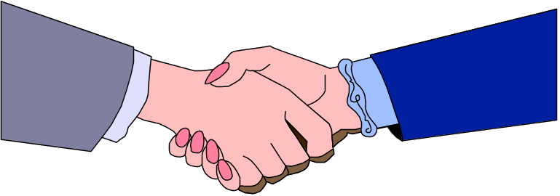
In OO environment, an application is the interactions and relationships among its domain objects.
All objects stand in relationship to others, on whom they rely for services and controls.
Object-Oriented Systems Development Bahrami © Irwin/ McGraw-Hill

Slide 6

Objects Relationships
Three types of relationships among objects are:
  Association.
  Super-sub structure (also known as generalization hierarchy).
  Aggregation and a-part-of structure.
Object-Oriented Systems Development Bahrami © Irwin/ McGraw-Hill

Slide 7

Associations
A reference from one class to another is an association.
Basically a dependency between two or more classes is an association.
For example, Jackie works for John.
Object-Oriented Systems Development Bahrami © Irwin/ McGraw-Hill

Slide 8

Associations (Con’t)
Some associations are implicit or taken from general knowledge.
Object-Oriented Systems Development Bahrami © Irwin/ McGraw-Hill

Slide 9
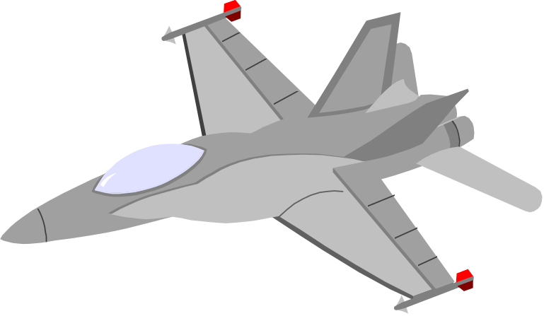
Guidelines For Identifying Associations
Association often appears as a verb in a problem statement and represents relationships between classes.
For example a pilot can fly planes.
Object-Oriented Systems Development Bahrami © Irwin/ McGraw-Hill

Slide 10

Guidelines For Identifying Associations (Con’t)
Association often corresponds to verb or prepositional phrases such as part of, next to, works for, contained in, etc.
Object-Oriented Systems Development Bahrami © Irwin/ McGraw-Hill

Slide 11
Common Association Patterns
Common association patterns include:
Location Association: next To, part of, contained in, ingredient of etc. :
For example cheddar cheese is an ingredient of the French soup.
Object-Oriented Systems Development Bahrami © Irwin/ McGraw-Hill
Notes:
The common association patterns are based on some of the common associations defined by researchers and practitioners: Rumbaugh et al., Coad and Yourdon, and others.

Slide 12

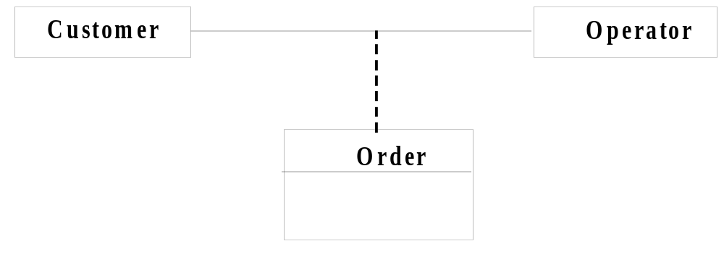
Common Association Patterns (Con’t)
Communication association—talk to, order to.
For example, a customer places an order with an operator person.
Object-Oriented Systems Development Bahrami © Irwin/ McGraw-Hill

Slide 13
Eliminate Unnecessary Associations
Implementation association. Defer implementation-specific associations to the design phase.
Ternary associations. Ternary or n-ary association is an association among more than two classes
Object-Oriented Systems Development Bahrami © Irwin/ McGraw-Hill

Slide 14
Eliminate Unnecessary Associations (Con’t)
Directed actions (derived) associations can be defined in terms of other associations.
Since they are redundant you should avoid these types of association.
Object-Oriented Systems Development Bahrami © Irwin/ McGraw-Hill

Slide 15
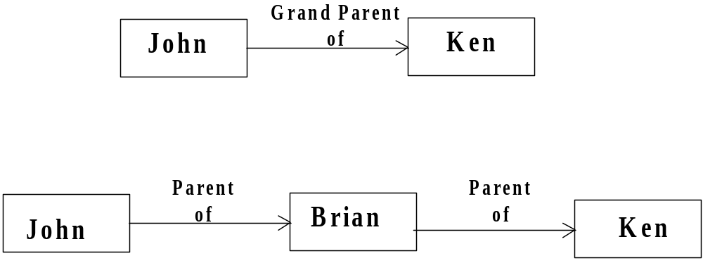
Eliminate Unnecessary Associations (Con’t)
Grandparent of Ken can be defined in terms of the parent association.
Object-Oriented Systems Development Bahrami © Irwin/ McGraw-Hill

Slide 16

Superclass-Subclass Relationships
Recall that at the top of the class hierarchy is the most general class, and from it descend all other, more specialized classes.
Sub-classes are more specialized versions of their super-classes.
Object-Oriented Systems Development Bahrami © Irwin/ McGraw-Hill

Slide 17
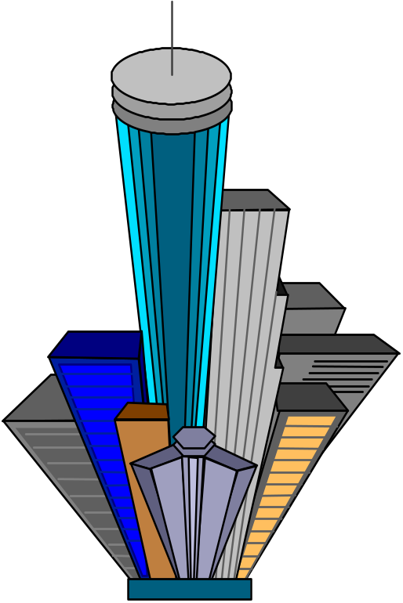
Guidelines For Identifying Super-sub Relationships: Top-down
Look for noun phrases composed of various adjectives on class name.
Example, Military Aircraft and Civilian Aircraft.
Only specialize when the sub classes have significant behavior.
Object-Oriented Systems Development Bahrami © Irwin/ McGraw-Hill

Slide 18
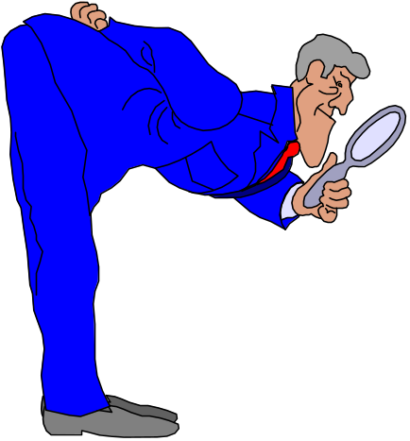
Guidelines For Identifying Super-sub Relationships: Bottom-up
Look for classes with similar attributes or methods.
Group them by moving the common attributes and methods to super class.
Do not force classes to fit a preconceived generalization structure.
Object-Oriented Systems Development Bahrami © Irwin/ McGraw-Hill

Slide 19

Guidelines For Identifying Super-sub Relationships: Reusability
Move attributes and methods as high as possible in the hierarchy.
At the same time do not create very specialized classes at the top of hierarchy.
This balancing act can be achieved through several iterations.
Object-Oriented Systems Development Bahrami © Irwin/ McGraw-Hill

Slide 20

Guidelines For Identifying Super-sub Relationships:
Multiple inheritance
Avoid excessive use of multiple inheritance.
It is also more difficult to understand programs written in multiple inheritance system.
Object-Oriented Systems Development Bahrami © Irwin/ McGraw-Hill

Slide 21
Multiple inheritance (Con’t)
One way to achieve the benefits of multiple inheritance is to inherit from the most appropriate class and add an object of other class as an attribute.
In essence, a multiple inheritance can be represented as an aggregation of a single inheritance and aggregation. This meta model reflects this situation.
Multiple Inheritance
Single Inheritance
Aggregation
Object-Oriented Systems Development Bahrami © Irwin/ McGraw-Hill

Slide 22
A-Part-of Relationship - Aggregation
A-part-of relationship, also called aggregation, represents the situation where a class consists of several component classes.
Object-Oriented Systems Development Bahrami © Irwin/ McGraw-Hill

Slide 23
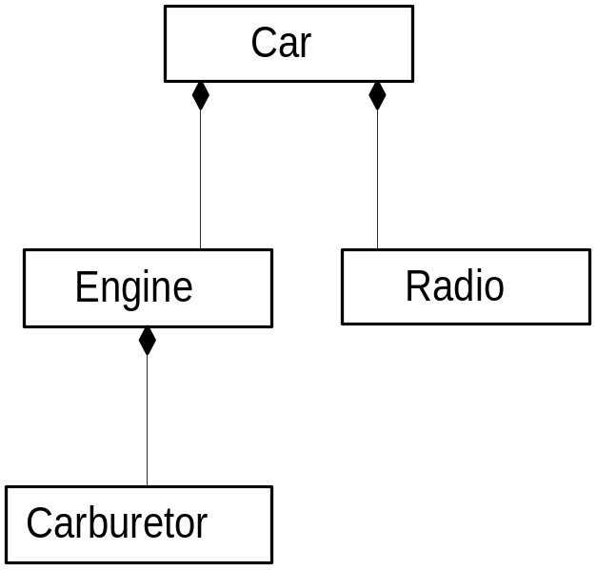
A-Part-of Relationship - Aggregation (Con’t)
This does not mean that the class behaves like its parts.
For example, a car consists of many other classes, one of them is a radio, but a car does not behave like a radio.
Object-Oriented Systems Development Bahrami © Irwin/ McGraw-Hill
Notes:
In Chapter 5, we saw that the UML uses hollow or filled diamonds to represent aggregations. A filled diamond signifies the strong form of aggregation, which is composition. For example, one might represent aggregation such as container and collection as hollow diamonds and use solid diamond to represent composition, which is a strong form of aggregation as in this example.

Slide 24
A-Part-of Relationship - Aggregation (Con’t)
Two major properties of a-part-of relationship are:
  transitivity
  antisymmetry
Object-Oriented Systems Development Bahrami © Irwin/ McGraw-Hill

Slide 25
Transitivity
If A is part of B and B is part of C, then A is part of C.
For example, a carburetor is part of an engine and an engine is part of a car; therefore, a carburetor is part of a car.
Object-Oriented Systems Development Bahrami © Irwin/ McGraw-Hill

Slide 26
Antisymmetry
If A is part of B, then B is not part of A.
For example, an engine is part of a car, but a car is not part of an engine.
Object-Oriented Systems Development Bahrami © Irwin/ McGraw-Hill

Slide 27

Where responsibilities for certain behavior must reside?
Does the part class belong to problem domain?
Is the part class within the system's responsibilities?
Object-Oriented Systems Development Bahrami © Irwin/ McGraw-Hill

Slide 28
where responsibilities ...(Con’t)
Does the part class capture more than a single value?
If it captures only a single value, then simply include it as an attribute with the whole class.
Does it provide a useful abstraction in dealing with the problem domain?
Object-Oriented Systems Development Bahrami © Irwin/ McGraw-Hill

Slide 29

A-Part-of Relationship Patterns
Assembly
An assembly-Part situation physically exists.
For example, a French soup consists of onion, butter, flour, wine, French bread, cheddar cheese, etc.
Object-Oriented Systems Development Bahrami © Irwin/ McGraw-Hill

Slide 30

A-Part-of Relationship Patterns
Container
A case such as course-teacher situation, where a course is considered as a container. Teachers are assigned to specific courses.
Object-Oriented Systems Development Bahrami © Irwin/ McGraw-Hill

Slide 31
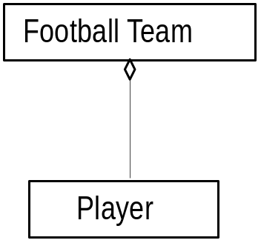

A-Part-of Relationship Patterns
Collection-Member
A soccer team is a collection of players.
Object-Oriented Systems Development Bahrami © Irwin/ McGraw-Hill

Slide 32
Class Responsibility: Identifying Attributes and Methods
Identifying attributes and methods, like finding classes, is a difficult activity.
The use cases and other UML diagrams will be our guide for identifying attributes, methods, and relationships among classes.
Object-Oriented Systems Development Bahrami © Irwin/ McGraw-Hill

Slide 33
Identifying Class Responsibility by Analyzing Use Cases and Other UML Diagrams
Attributes can be identified by analyzing the use cases, sequence/collaboration, activity, and state diagrams.
Object-Oriented Systems Development Bahrami © Irwin/ McGraw-Hill

Slide 34
Responsibility
How am I going to be used?
How am I going to collaborate with other classes?
How am I described in the context of this system's responsibility?
What do I need to know?
What state information do I need to remember over time?
What states can I be in?
Object-Oriented Systems Development Bahrami © Irwin/ McGraw-Hill
Notes:
Ask students to imagine themselves as objects in an object-oriented environment, what kind of questions would they like to ask?

Slide 35

Assign Each Responsibility To A Class
Assign each responsibility to the class that it logically belongs to.
This also aids us in determining the purpose and the role that each class plays in the application.
Object-Oriented Systems Development Bahrami © Irwin/ McGraw-Hill

Slide 36

Object Responsibility: Attributes
Information that the system needs to remember.
Object-Oriented Systems Development Bahrami © Irwin/ McGraw-Hill

Slide 37

Guidelines For Identifying Attributes Of Classes
Attributes usually correspond to nouns followed by possessive phrases such as cost of the soup.
Object-Oriented Systems Development Bahrami © Irwin/ McGraw-Hill

Slide 38

Guidelines For Identifying Attributes Of Classes (Con’t)
Keep the class simple; only state enough attributes to define the object state.
Object-Oriented Systems Development Bahrami © Irwin/ McGraw-Hill

Slide 39
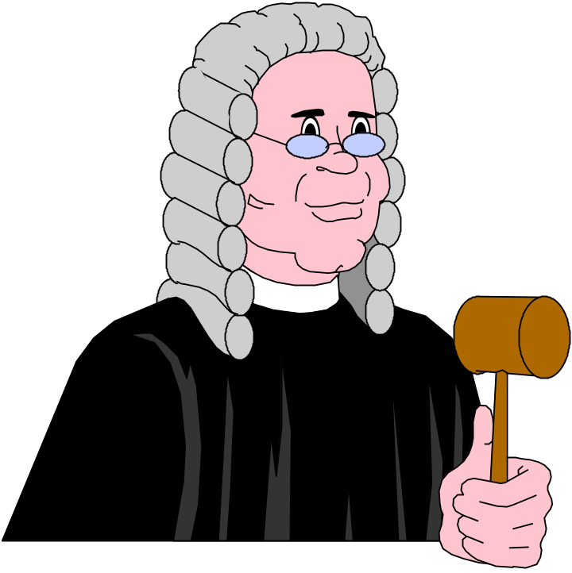
Guidelines For Identifying Attributes Of Classes (Con’t)
Attributes are less likely to be fully described in the problem statement.
You must draw on your knowledge of the application domain and the real world to find them.
Object-Oriented Systems Development Bahrami © Irwin/ McGraw-Hill

Slide 40
Guidelines For Identifying Attributes Of Classes (Con’t)
Omit derived attributes.
For example, don't use age as an attribute since it can be derived from date of birth.
Drive attributes should be expressed as a method.
Object-Oriented Systems Development Bahrami © Irwin/ McGraw-Hill

Slide 41

Guidelines For Identifying Attributes Of Classes (Con’t)
Do not carry discovery of attributes to excess.
You can always add more attributes in the subsequent iterations.
Object-Oriented Systems Development Bahrami © Irwin/ McGraw-Hill

Slide 42

Object Responsibility: Methods & Messages
Methods and messages are the work horses of object-oriented systems.
In O-O environment, every piece of data, or object, is surrounded by a rich set of routines called methods.
Object-Oriented Systems Development Bahrami © Irwin/ McGraw-Hill

Slide 43
Identifying Methods by Analyzing UML Diagrams and Use Cases
Sequence diagrams can assist us in defining the services the objects must provide.
Object-Oriented Systems Development Bahrami © Irwin/ McGraw-Hill

Slide 44
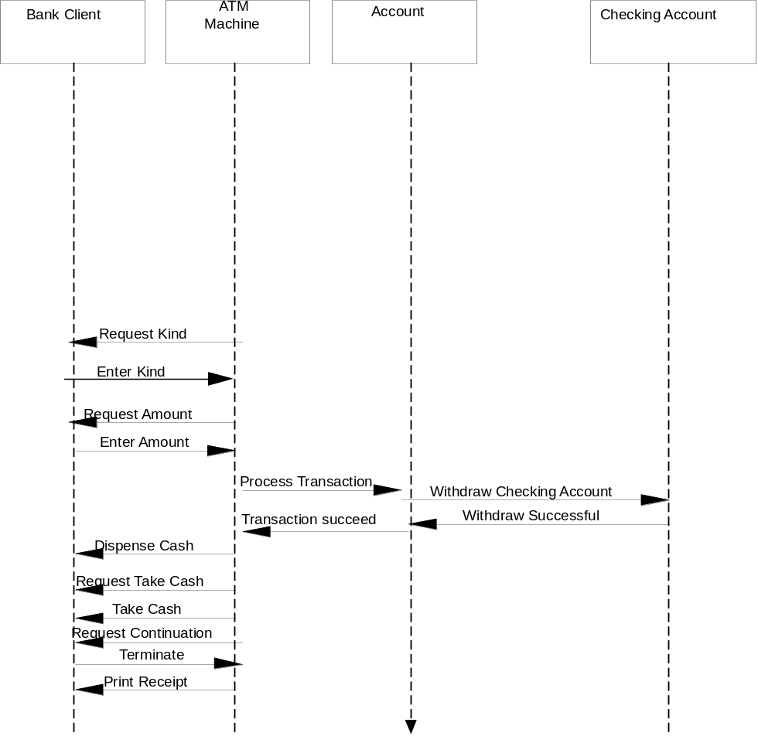
Identifying Methods (Con’t)
Object-Oriented Systems Development Bahrami © Irwin/ McGraw-Hill
Notes:
For example, by studying the sequence diagram for Withdraw Checking, it is clear that the Account class (which is the superclass of CheckingAccount and SavingsAccount) must provide a service such as withdrawal.

Slide 45
Identifying Methods (Con’t)
Methods usually correspond to queries about attributes (and sometimes association) of the objects.
Methods are responsible for managing the value of attributes such as query, updating, reading and writing.
Object-Oriented Systems Development Bahrami © Irwin/ McGraw-Hill

Slide 46

Identifying Methods (Con’t)
For example, we need to ask the following questions about soup class:
What services must a soup class provide? And
What information (from domain knowledge) is soup class responsible for storing?
Object-Oriented Systems Development Bahrami © Irwin/ McGraw-Hill

Slide 47
Identifying Methods (Con’t)
Let's first take a look at its attributes which are:
name
preparation,
price,
preparation time and
oven temperature.
Object-Oriented Systems Development Bahrami © Irwin/ McGraw-Hill

Slide 48
Identifying Methods (Con’t)
Now we need to add methods that can maintain these attributes.
For example, we need a method to change a price of a soup and another operation to query about the price.
Object-Oriented Systems Development Bahrami © Irwin/ McGraw-Hill

Slide 49
Identifying Methods (Con’t)
setName
getName
setPreparation
get Preparation
setCost
getCost
setOvenTemperature
getOvenTemperature
setPreparationTime
getPreparationTime
Object-Oriented Systems Development Bahrami © Irwin/ McGraw-Hill

Slide 50

Summary
We learned how to identify three types of object relationships:
Association
Super-sub Structure (Generalization Hierarchy)
A-part-of Structure
Object-Oriented Systems Development Bahrami © Irwin/ McGraw-Hill

Slide 51
Summary (Con’t)
The hierarchical relation allows the sharing of properties or inheritance.
A reference from one class to another is an association.
The A-Part-of Structure is a special form of association.
Object-Oriented Systems Development Bahrami © Irwin/ McGraw-Hill

Slide 52
Summary (Con’t)
Every class is responsible for storing certain information from domain knowledge .
Every class is responsible for performing operations necessary upon that information.
Object-Oriented Systems Development Bahrami © Irwin/ McGraw-Hill

